Slide 1
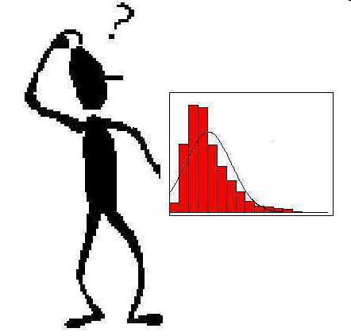
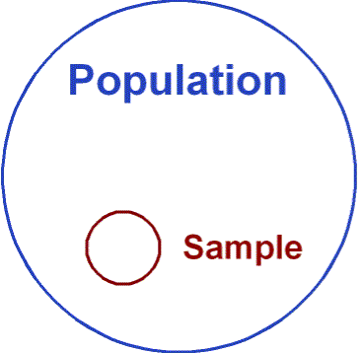
Non-parametric statistics
Notes:
Last weeks lecture was about t tests. At the time I did not tell you that t tests are a member of a family of statistical tests called parametric tests. They are called parametric tests because they use sample to make inferences about population parameters (the mean of a population is technically known as a parameter, whereas the mean of a sample is technically known as a statistic). Now, parametric tests are only appropriate when the data is of a good quality and certain assumptions are met. When those assumptions are not met we need to se a different set of tests from a family called non-parametric tests. Today’s lecture will seek to do two things – guide you through the process of learning how to decide between parametric and non-parametric tests, and then explain the rationale of the nonparametric tests and how to report them.

Slide 2
Parametric vs. non-parametric
The t test covered in Lecture 5 is an example of a “parametric test”
Parametric tests assume the data is of sufficient “quality”
the results can be misleading if assumptions are wrong
“Quality” is defined in terms of certain properties of the data
Non-parametric tests can be used when the data is not of sufficient quality to satisfy the assumptions of parametric test
Parametric tests are preferred when the assumptions are met because they are more sensitive, and many of the parametric tests you will encounter in year 2 have no non-parametric equivalent
Chapter 15 of the Andy Field textbook covers non-parametric tests
Chapter 5 covers assumptions in detail
Chapter 9 (9.3.2 and 9.8) covers specific assumptions of t tests
Notes:
The last bullet point explains why we don’t always use non-parametric tests.
Sensitivity refers to the tests ability to reject the null hypothesis for a sample, given that it is actually false in the population.

Slide 3
Assumptions of t tests – a list
The sampling distribution is normally distributed
We don’t have access to the sampling distribution
But the central limit theorem (text book 2.5.1) indicates that the sampling distribution will always be normal if sample size is 30 or greater
For N < 30 if the sample data is normally distributed then the sampling distribution will also be normal
For an independent samples t test this means both samples should be normally distributed
For a related samples t test or a one sample t test this means the difference scores, not the raw scores, should be normally distributed
The data should come from an interval or ratio scale
in practice an ordinal scale with 5 or more levels is ok
Notes:
The reason the sampling distribution needs to be normally distributed is because the t distribution that was shown visually in lecture 5 is built using 2 assumptions. The first assumption is that the null hypothesis is true, and the second assumption is the underlying population of scores that has been sampled from is normally distributed. If the underlying population of scores was quite skewed, and the null hypothesis was true, then the frequency histogram of a large number of small samples from the population would not look like a t distribution. In a sense, the t distribution is a model of the underlying sampling distribution.

Slide 4
Assumptions of t tests – a list
There should not be extreme scores or outliers, because these have a disproportionate influence on the mean and the variance
For the independent samples t test the variance in the two samples should be approximately equal
This assumption is more important if sample size < 30 and / or sample sizes are unequal
As a rule of thumb, if the variance of one group is 3 or more times greater than the variance of the other group, then use non-parametric

Slide 5
Assumption 1 - normality
This can be checked by inspecting a histogram
with small samples the histogram is unlikely to ever be exactly bell shaped
This assumption is only broken if there are large and obvious departures from normality

Slide 6
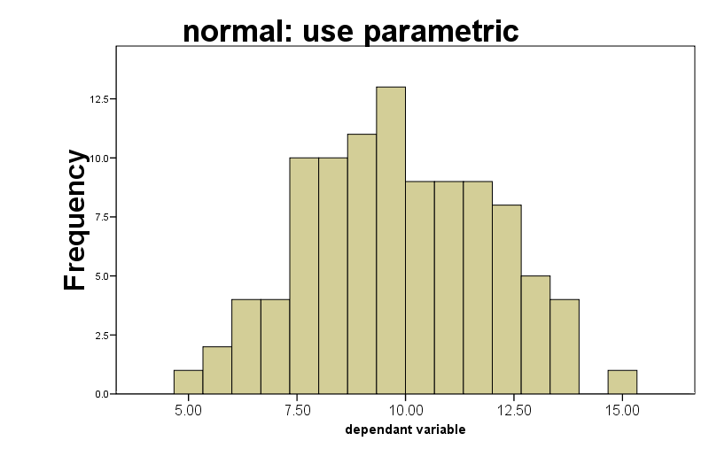
Assumption 1 - normality
Notes:
I want you to test the normality assumption by plotting histograms and making a visual judgment. There are more formal ways, but they all have problems anyway.

Slide 7
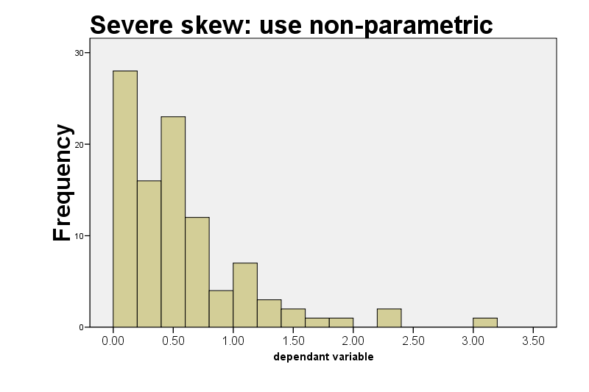
Assumption 1 - normality
In severe skew the most extreme histogram interval usually has the highest frequency

Slide 8
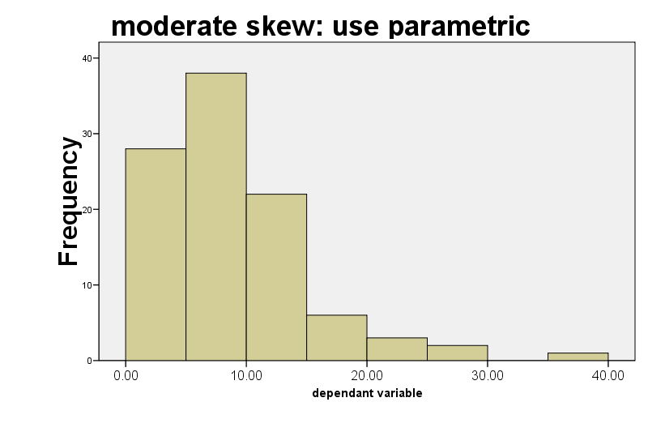
Assumption 1 - normality
In moderate skew the most extreme histogram interval does not have the highest frequency

Slide 9
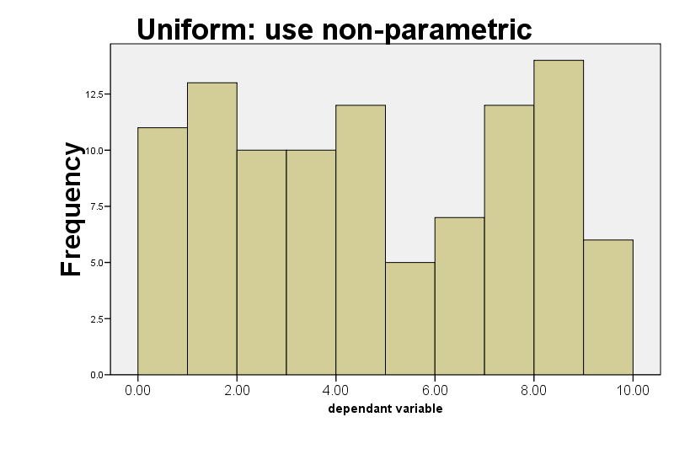
Assumption 1 - normality
Notes:
A uniform distribution is one with no clear peak in the middle, or even to the left or right. Such as obtained by rolling a dice many times.

Slide 10
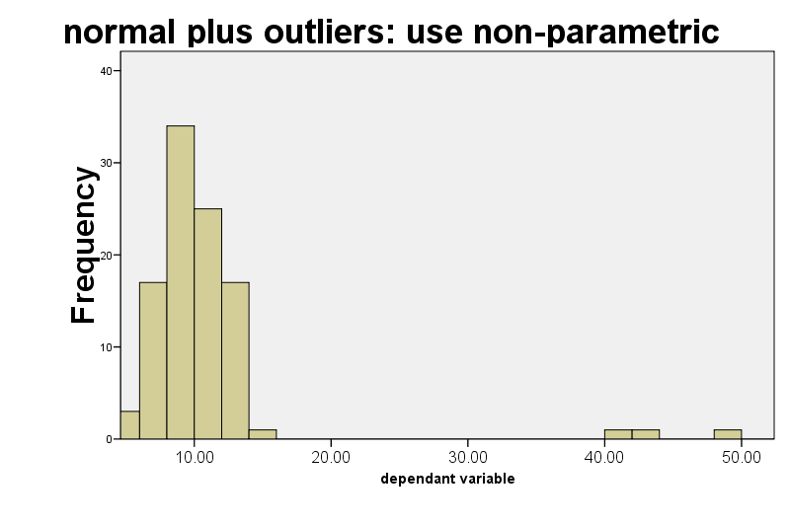
Assumption 3 – no extreme scores
It is sometimes legitimate to exclude extreme scores from the sample or alter them to make them less extreme. See section 5.7.1 of the textbook. You may then use parametric.
Notes:
Remember that extreme scores have a disproportionate influence on means and variance. If you find extreme scores you can use non-parametric. An alternative is to alter the extreme scores so that they are still the highest in the data, but only by a small amount rather than a huge amount. Another alternative is to exclude those data points and use a parametric test. To do that you have to make the case that those data points are from “another” population and were sampled by accident. this can include things like a participant who did not try to do the experiment properly.

Slide 11
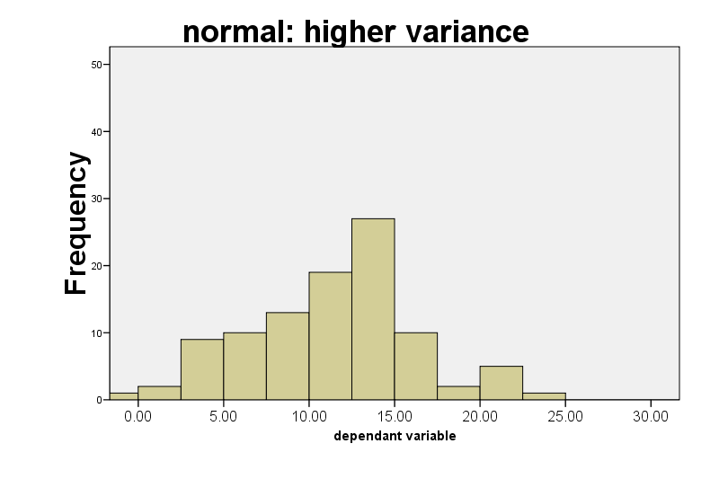
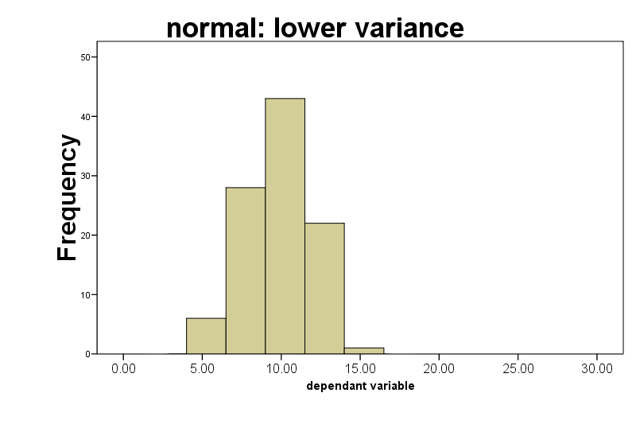
Assumption 4 (independent samples t only) – equal variance
Variance 25.2
Variance 4.1
Notes:
These two histograms illustrate a fairly extreme example of a common problem. The sample sizes are the same, and I have adjusted the histogram x and y axis values so that the two graphs are directly comparable. Both samples conform to a normal distribution. It is clear that the means are similar, but the variance / SD is very different. If you calculate descriptive statistics and the variance of one group is 3 times bigger than the other you need to use a non-parametric test. Otherwise, you can get away with a corrected version of the t test (see later)

Slide 12
Assumption 4 – equal variances (independent samples t only)
Sometimes, the variance in the two groups is unequal, but the larger variance is less than 3 times bigger than the smaller variance
In this case you can perform a t test with a correction for unequal variance
SPSS provides a statistical test, called Levene’s Test, of the null hypothesis that the variances in the two groups are the same
If that null hypothesis is rejected you need to make a correction to the t test
If the variance of one group is 3 or more times bigger than the other then perform a Mann Whitney U test (see later)

Slide 13
Levene’s test and correcting for unequal variance
variances are 25.4 and 60.7
Notes:
The SPSS output for the t test gives you the SD instead of variance (annoyingly) so you need to square the SD or get it from another SPSS operation, such as Explore, in order to check the *3 rule. In this case the *3 rule is not violated so we can use a t test.
When performing an independent samples t test, if the two sample SD’s are even slightly different you should first check if the Levene’s test for equality of variances is significant. If and only if it is non-significant (i.e. p > 0.05), then this fails to rejects the null hypothesis that the two sample variances are equal, allowing you treat them as equal. If Levene's test suggests that the variances are unequal you should then report the t test values from the bottom row “equal variances not assumed”. The value of t is sometimes different, and the df will be reduced, and will have decimal places. Just report the values from the bottom row instead of the top row.

Slide 14
Levene’s test and correcting for unequal variance
variances are 25.4 and 60.7
Notes:
The SPSS output for the t test gives you the SD instead of variance (annoyingly) so you need to sqaure the SD or get it from another SPSS operation, such as Explore, in order to check the *3 rule. In this case the *3 rule is not violated so we can use a t test.
When performing an independent samples t test, if the two sample SD’s are even slightly different you should first check if the Levene’s test for equality of variances is significant. If and only if it is non-significant (i.e. p > 0.05), then this fails to rejects the null hypothesis that the two sample variances are equal, allowing you treat them as equal. If Levene's test suggests that the variances are unequal you should then report the t test values from the bottom row “equal variances not assumed”. The value of t is sometimes different, and the df will be reduced, and will have decimal places. Just report the values from the bottom row instead of the top row.

Slide 15
Digression: testing the null hypothesis that two samples have the same variance
Suppose some researchers predict that children educated in a traditional way will have a greater range of scores in end of year tests compared to the modern approach
40 children are randomly allocated to either traditional or modern classrooms
The Levene’s Test can be used to test the null hypothesis that the two groups show the same amount of dispersion around the mean

Slide 16
Non-parametric tests
These are sometimes referred to as “distribution free” tests, because they do not make assumptions about the normality or variance of the data
The Mann Whitney U test is appropriate for a 2 condition independent samples design
The Wilcoxon Signed Rank test is appropriate for a 2 condition related samples design
If you have decided to use a non-parametric test then the most appropriate measure of central tendency will probably be the median
Notes:
Just as the related samples t test was able to make use of difference scores as a way of reducing the error term, so the wilcoxon will also be able to make use of difference scores in its ranking procedure. Difference scores may not be used in any independent samples procedure.

Slide 17
Mann-Whitney U test
15.3
To avoid making the assumptions about the data that are made by parametric tests, the Mann-Whitney U test first converts the data to ranks.
If the data were originally measured on an interval or ratio scale then after converting to ranks the data will have an ordinal level of measurement

Slide 18
Mann-Whitney U test: ranking the data
Sample 1 |  | Sample 2
Score | Rank 1 | Score | Rank 2
7 | 3 | 6 | 2
13 | 8 | 12 | 7
8 | 4 | 4 | 1
9 | 5.5 | 9 | 5.5

Slide 19
Mann-Whitney U test: ranking the data
Sample 1 |  | Sample 2
Score | Rank 1 | Score | Rank 2
7 | 3 | 6 | 2
13 | 8 | 12 | 7
8 | 4 | 4 | 1
9 | 5.5 | 9 | 5.5
Scores are ranked irrespective of which experimental group they come from

Slide 20
Mann-Whitney U test: ranking the data
Sample 1 |  | Sample 2
Score | Rank 1 | Score | Rank 2
7 | 3 | 6 | 2
13 | 8 | 12 | 7
8 | 4 | 4 | 1
9 | 5.5 | 9 | 5.5
Tied scores take the mean of the ranks they occupy. In this example, ranks 5 and 6 are shared in this way between 2 scores. (Then the next highest score is ranked 7)

Slide 21
Rationale of Mann-Whitney U
Imagine two samples of scores drawn at random from the same population
The two samples are combined into one larger group and then ranked from lowest to highest
In this case there should be a similar number of high and low ranked scores in each original group
if you sum the ranks in each group the totals should be about the same
this is the null hypothesis
If however, the two samples are from different populations with different medians then most of the scores from one sample will be lower in the ranked list than most of the scores from the other sample
the sum of ranks in each group will differ

Slide 22
Mann-Whitney U test: sum of ranks
Sample 1 |  | Sample 2
Score | Rank 1 | Score | Rank 2
7 | 3 | 6 | 2
13 | 8 | 12 | 7
8 | 4 | 4 | 1
9 | 5.5 | 9 | 5.5
Sum of ranks | 20.5 |  | 15.5
The next step in computing the Mann-Whitney U is to sum the ranks in the two groups
Notes:
In this example the summed ranks for one group is higher than the other, and this begins to suggest that the sorted and ranked scores are not arranged at random in the combined list of ranked scores, so maybe the null hypothesis is going to be rejected in this case.
The summed ranks are converted to the U statistic using a formula that takes into account the sample size.

Slide 23
Mann Whitney U - SPSS
The value of U is calculated using a formula that compares the summed ranks of the two groups and takes into account sample size
You don’t need to know the formula
Notes:
The summed ranks are converted to the U statistic using a formula that takes into account the sample size (you don’t need to know the details of this). In order to convert U to a p value, SPSS first converts U to a value on the standard normal distribution, i.e. a Z score.

Slide 24
Mann Whitney U - SPSS
You should generally report the asymptotic p value
To calculate this SPSS converts the value of U to a Z score, i.e. a value on the standard normal distribution
The Z score is converted to a p value in the same way as for the Z test (lecture 4)
Notes:
The summed ranks are converted to the U statistic using a formula that takes into account the sample size (you don’t need to know the details of this). In order to convert U to a p value, SPSS first converts U to a value on the standard normal distribution, i.e. a Z score.

Slide 25
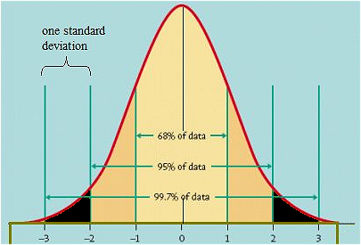
Notes:
Here is a standard normal distribution, and the x axis in units of SD is the same as the z statistic. The values z must exceed for a two tailed 0.05 p value are colored in black. In the mann whitney example on the preceding slide, you can see that the z o -1.22 is not sufficiently extreme to pass 0.05. If you drew a single case at random from the z distribution it would be 22% likely to have an unsigned value of greater than 1.22.

Slide 26
Mann Whitney U - reporting
“As the data was skewed, and the two sample sizes were unequal, the most appropriate statistical test was Mann-Whitney. Descriptive statistics showed that group 1 (median = ____ ) scored higher on the DV than group 2 (median = ____). However, the Mann-Whitney U was found to be 51 (Z = -1.21), p > 0.05, and so the null hypothesis that the difference between the medians arose through sampling effects cannot be rejected.”
For a significant result: “….. Mann-Whitney U was found to be 276.5 (Z = -2.56), p = 0.01 (one-tailed), and so the null hypothesis that the difference between the medians arose through sampling effects can be rejected in favour of the alternative hypothesis that the IV had an influence on the DV.”
Notes:
Notice that SPSS converts the value of U to a z score, which is a value on the standard normal distribution (SND). The P value it reports is just the probability of a z score of that magnitude being picked by random sampling of a single score from the SND. You should recall that z score 1.95 = 0.05, z score 2.5 = 0.01 and z score 3 = 0.001 in terms of probability.
Note that if the hypothesis was two tailed you’d need to indicate that instead of one-tailed in the significant version of reporting a result.

Slide 27
Wilcoxon signed ranks test
15.4
This is appropriate for within participants designs
The t test lecture used a within participants example based upon testing reaction time in the morning and in the afternoon, using the same group of participants in both conditions
The Wilcoxon test is conceptually similar to the related samples t test
between subjects variation is minimised by calculation of difference scores

Slide 28
Wilcoxon test: ranking the data
Score cond 1 | Score cond 2 | Difference | Ranked dif ignoring + /-
3 | 7 | -4 | 3.5
5 | 6 | -1 | 1
5 | 3 | 2 | 2
4 | 8 | -4 | 3.5
First rank the difference scores, ignoring the sign of the difference. Differences of 0 receive no rank

Slide 29
Rationale of Wilcoxon test
Some difference scores will be large, others will be small
Some difference scores will be positive, others negative
If there is no difference between the two experimental conditions then there will be similar numbers of positive and negative difference scores
If there is no difference between the two experimental conditions then the numbers and sizes of positive and negative differences will be equal
this is the null hypothesis
If there is a differences between the two experimental conditions then there will either be more positive ranks than negative ones, or the other way around
Also, the larger ranks will tend to lie in one direction

Slide 30
Wilcoxon test: ranking the data
Score cond 1 | Score cond 2 | Difference | Ranked dif ignoring + /- | Ranked dif +/- reattached
3 | 7 | -4 | 3.5 | -3.5
5 | 6 | -1 | 1 | -1
5 | 3 | 2 | 2 | 2
4 | 8 | -4 | 3.5 | -3.5
Add the sign of the difference back into the ranks

Slide 31
Wilcoxon test: ranking the data
Score cond 1 | Score cond 2 | Difference | Ranked dif ignoring + /- | Ranked dif +/- reattached
3 | 7 | -4 | 3.5 | -3.5
5 | 6 | -1 | 1 | -1
5 | 3 | 2 | 2 | 2
4 | 8 | -4 | 3.5 | -4
Separately, sum the positive ranks and the negative ranks. In this example the positive sum is 2 and the negative sum is -8.5. The Wilcoxon T is whichever is smaller (2 in this case)
Notes:
There is an imbalance in the sum of the ranks for this very small data set, suggesting that the null hypothesis might be rejected

Slide 32
Wilcoxon T - SPSS
The value of T is equal to whichever of the mean ranks is lower
T is converted to a Z score by SPSS, taking into account sample size, and the p value is derived from the standard normal distribution

Slide 33
Wilcoxon T - reporting
“As the difference scores were not normally distributed, the most appropriate statistical test was the Wilcoxon signed-rank test. Descriptive statistics showed that measurement in condition 1 (median = ____ ) produced higher scores than in condition 2 (median = ____). The Wilcoxon test (T = 2.17) was converted into a Z score of -2.73, p = 0.006 (two tailed). It can therefore be concluded that the experimental and control treatments produced different scores.”
Notes:
Note that you still have to deal with the one tailed versus two tailed thing with Wilcoxon. SPSS gives 2 tailed probability.

Slide 34
Limitations of non-parametric methods
Converting ratio level data to ordinal ranked data entails a loss of information
This reduces the sensitivity of the non-parametric test compared to the parametric alternative in most circumstances
sensitivity is the power to reject the null hypothesis, given that it is false in the population
lower sensitivity gives a higher type 2 error rate
Many parametric tests have no non-parametric equivalent
e.g. Two way ANOVA, where two IV’s and their interaction are considered simultaneously
Notes:
Converting the times that runners take to complete a marathon into finishing positions caused you to loose the information that tells you whether the race was close or had a clear winner
ANOVA will be covered next year. In ANOVA you might have an experiment with 4 conditions, made up of a 2 by 2 grid of two IV’s each of which has two levels. For example, we might measure reaction time in the morning and the afternoon, and we might also test the effect of caffeine versus no caffeine. This results in four groups (caffeine morning, caffeine afternoon, no-caffeine morning, and no-caffeine afternoon). Such a design allows you to assess the “interaction”, i.e. whether the effects of caffeine on rtm are different in the morning compared to the effect of caffeinge on rtm in the afternoon. (Unfortunately, there is no non-parametric method for assessing the “interaction”)

